Slide 1

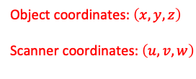



channels
Object coordinates: $\left(x, y, z\right)$
Scanner coordinates: $\left(u,v,w\right)$
rows
$$w$$
$$β$$
Detector Pixel
$$\text{Rotation}$$
$$\text{axis}$$
$$\text{Voxel}$$
$$\left(u_{d0}, v_{p}, w_{p}\right)$$
$$\left(u_{v}, v_{v}, w_{v}\right)$$
$$\text{Source}$$
$$Δ_{v}$$
channel_offset
$$\left(u_{s}, 0,0\right)$$
$$v$$
$$\left(0,0,0\right)$$
$$u$$
row_offset
$$\left(0,v_{r},0\right)$$
rotation_offset
$$β$$

Slide 2
view angles
Source
object
Detector

Slide 3

view angles
$$θ$$
Source
Detector

